Slide 1
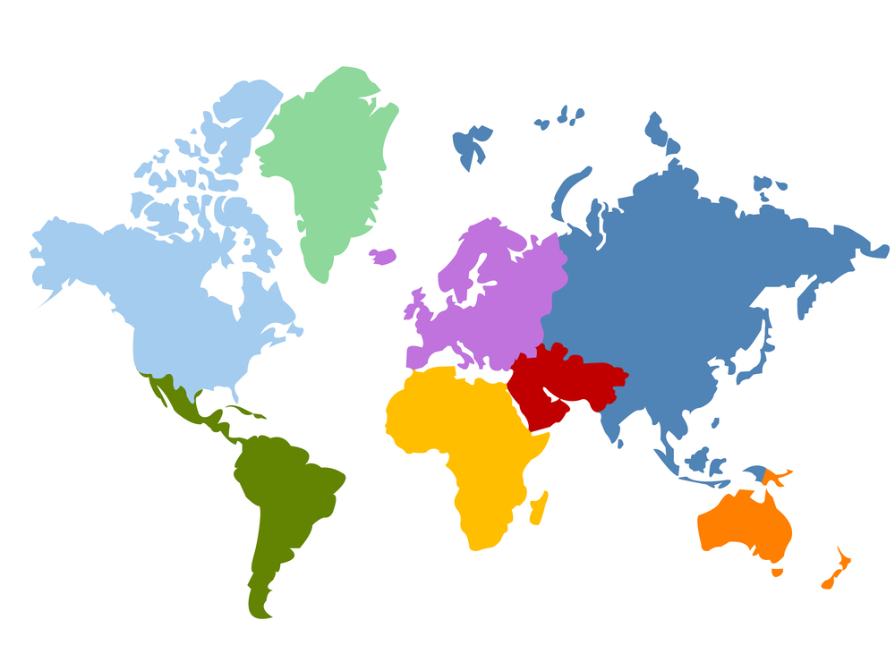
Part I Building Blocks
8 Indicators & Case Studies
Measuring Poverty Rates using Malawi Data
How can we measure poverty by district and region using household data?

Slide 2
Lecture Outline
1. Background of Household Survey
Three new commands to know:
2. Case Study & Data Analytics Lesson:
Measuring Poverty Rates in Malawi
summarize()
merge()
grouped_stats() & weights
+ Discussion on how to improve the poverty rate measurement.

Slide 3
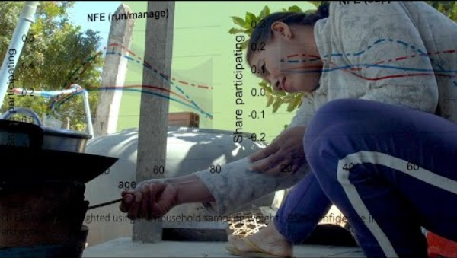
LSMS+ Survey in Cambodia (link)

Slide 4

Living Standard Measurement Study (LSMS) Surveys
There are many types of household surveys conducted in many countries. Modern surveys started after World War II.
We will explore various ones in this class. One of the established survey programs for developing nations is the LSMS Surveys.
Established by the World Bank in 1980s.
Need a way to track poverty and living standard measurements through time and have them consistent across countries.
Check out World Bank Microdata Library
Also The LSMS Homepage

Slide 5
Topics of Household Surveys
Go to bit.ly/survey_malawi
Multi-topic surveys have been quite extensive in the topics they cover.
For LSMS, topics cover:
Household characteristics
Household consumption
Labor, time use, and income
Agricultural activities (land size, what is planted, what is harvested)
Bank account, savings, and credit
Access to Mobile Phones
Food security
Subjective wellbeing
Education
Health
Fertility
…………. and so on.
Keep this in mind for your group policy report!

Slide 6
Example Papers using the Malawi Data
Chen, Chaoran, Diego Restuccia, and Raül Santaeulàlia-Llopis. (2023). Land Misallocation and Productivity. American Economic Journal: Macroeconomics 15 (2): 441–65.
Jones, A. D., Shrinivas, A., & Bezner-Kerr, R. (2014). Farm production diversity is associated with greater household dietary diversity in Malawi: Findings from nationally representative data. Food Policy, 46, 1-12.
Duchoslav, J., Kenamu, E., & Thunde, J. (2023). Targeting hunger or votes? The political economy of humanitarian transfers in Malawi. World Development, 165, 106179.
McLaughlin, S. M., Bozzola, M., & Nugent, A. (2023). Changing Climate, Changing Food Consumption? Impact of Weather Shocks on Nutrition in Malawi. The Journal of Development Studies, 59(12), 1827–1848.

Slide 7
Lecture Outline
1. Background of Household Survey
Three new commands to know:
2. Case Study & Data Analytics Lesson:
Measuring Poverty Rates in Malawi
summarize()
merge()
grouped_stats() & weights
+ Discussion on how to improve the poverty rate measurement.

Slide 8
Recap: How do I start building code?
The code structure is already built for you. But it’s good to start learning the logic of how to build code.
Start with understanding what input you have
Now I have multiple files!!!
Consumption data that I have is very detailed. More information than what I needed.
Think about what kind of output you want
Need to create an indicator that identifies whether a household lives under the poverty line or not.
Find the proportion of people who are identified as living below the poverty line.
Think about the steps needed to get there

Slide 9
summarize()
From package dplyr
Type in console: help(“summarize”)
Use this to summarize each group into one row.
In case study we have too much information in consumption. Instead, we want to create one total row for each household.
summarize(food_cons, Total_Food_Exp = sum(hh_g05, na.rm = TRUE), .by = (case_id))

Slide 10
summarize()
From package dplyr
Type in console: help(“summarize”)
Use this to summarize each group into one row.
In case study we have too much information in consumption. Instead, we want to create one total row for each household.
summarize(food_cons, Total_Food_Exp = sum(hh_g05, na.rm = TRUE), .by = (case_id))
food_cons is the dataset that contains the variable I want to summarize.

Slide 11
summarize()
From package dplyr
Type in console: help(“summarize”)
Use this to summarize each group into one row.
In case study we have too much information in consumption. Instead, we want to create one total row for each household.
summarize(food_cons, Total_Food_Exp = sum(hh_g05, na.rm = TRUE), .by = (case_id))
The second input is the name for the new variable.

Slide 12
summarize()
From package dplyr
Type in console: help(“summarize”)
Use this to summarize each group into one row.
In case study we have too much information in consumption. Instead, we want to create one total row for each household.
summarize(food_cons, Total_Food_Exp = sum(hh_g05, na.rm = TRUE), .by = (case_id))
sum() is the type of aggregation I want to do. Other aggregations are possible.

Slide 13
summarize()
From package dplyr
Type in console: help(“summarize”)
Use this to summarize each group into one row.
In case study we have too much information in consumption. Instead, we want to create one total row for each household.
summarize(food_cons, Total_Food_Exp = sum(hh_g05, na.rm = TRUE), .by = (case_id))
The variable that I want to aggregate.

Slide 14
summarize()
From package dplyr
Type in console: help(“summarize”)
Use this to summarize each group into one row.
In case study we have too much information in consumption. Instead, we want to create one total row for each household.
summarize(food_cons, Total_Food_Exp = sum(hh_g05, na.rm = TRUE), .by = (case_id))
When aggregating, ignore missings.

Slide 15
summarize()
From package dplyr
Type in console: help(“summarize”)
Use this to summarize each group into one row.
In the case study we have too much information in consumption. Instead, we want to create one total row for each household.
summarize(food_cons, Total_Food_Exp = sum(hh_g05, na.rm = TRUE), .by = (case_id))
Sum up the total by household id. The variable is case_id.

Slide 16
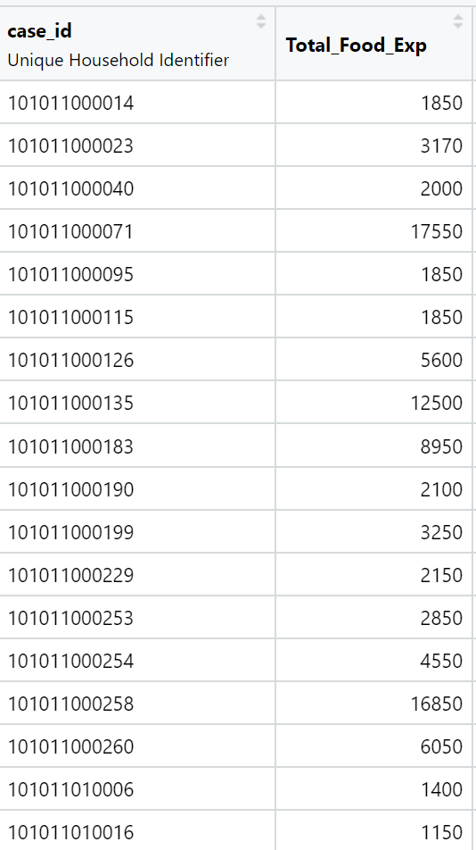
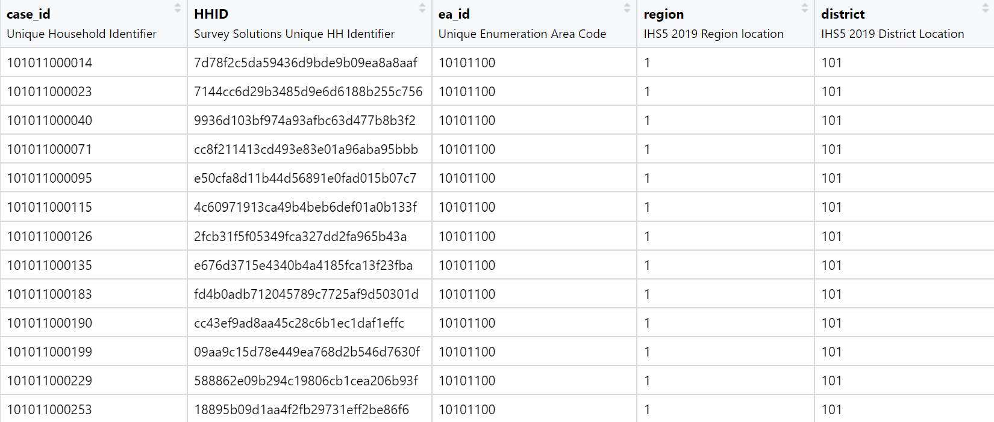
Merging Data (Connecting the data into one)
Dataset I:
Total Food Consumption by Household
Dataset II:
Household Information

Slide 17
Merging Data (Connecting the data into one)
merge(x=food_exp_by_hh, y=hh_info, by.x="case_id", by.y="case_id")
x= the name of the first dataset.

Slide 18
Merging Data (Connecting the data into one)
merge(x=food_exp_by_hh, y=hh_info, by.x="case_id", by.y="case_id")
y= the name of the second dataset.

Slide 19
Merging Data (Connecting the data into one)
merge(x=food_exp_by_hh, y=hh_info, by.x="case_id", by.y="case_id")
Specify the variable in the first dataset for connecting.

Slide 20
Merging Data (Connecting the data into one)
merge(x=food_exp_by_hh, y=hh_info, by.x="case_id", by.y="case_id")
Specify the variable in the second dataset for connecting.

Slide 21
grouped_stats()
From package flashlight
Type in console: help(“grouped_stats”)
Use this to calculate weighted means.
To calculate a mean that represents the population, we need to include weights. A normal mean calculation will be biased.
grouped_stats(merged_data, "below_poverty_line", w = "hh_wgt")

Slide 22
grouped_stats()
From package flashlight
Type in console: help(“grouped_stats”)
Use this to calculate weighted means.
To calculate a mean that represents the population, we need to include weights. A normal mean calculation will be biased.
grouped_stats(merged_data, "below_poverty_line", w = "hh_wgt")
Dataset where the variable of interest is.

Slide 23
grouped_stats()
From package flashlight
Type in console: help(“grouped_stats”)
Use this to calculate weighted means.
To calculate a mean that represents the population, we need to include weights. A normal mean calculation will be biased.
grouped_stats(merged_data, "below_poverty_line", w = "hh_wgt")
The name of the variable that you want to average.

Slide 24
grouped_stats()
From package flashlight
Type in console: help(“grouped_stats”)
Use this to calculate weighted means.
To calculate a mean that represents the population, we need to include weights. A normal mean calculation will be biased.
grouped_stats(merged_data, "below_poverty_line", w = "hh_wgt")
The name of the column in the data that contains the weights.

Slide 25

What are weights?
Weights are used to make the data representative of the population.
Without weights, the poverty rate calculated will be the poverty rates for the 11434 households in the sample instead of the entire population of Malawi.
Weighted mean of consumption:
$$\hat{weighted mean}=$$
$\frac{∑w_{group i}∗consumption_{group_{i}}}{∑w_{group i}}$
$w_{group i}$: weight for group i
Sum over all groups.

Slide 26
What adjustments should you make to create better measurements?

Slide 27
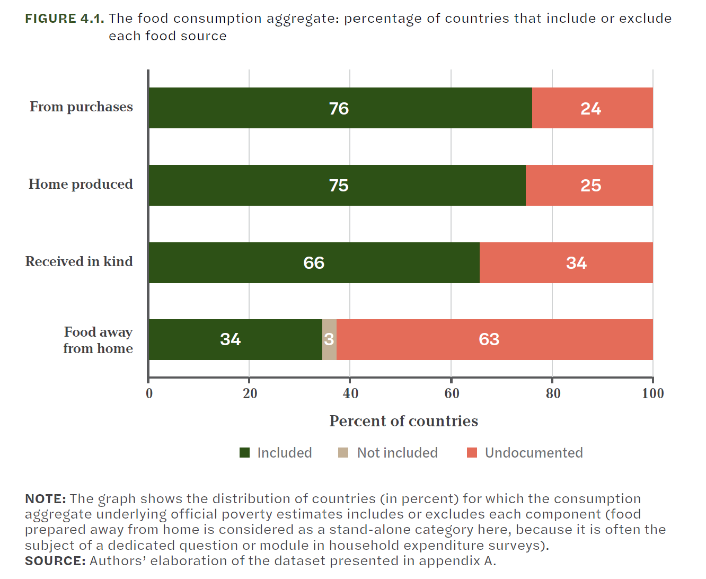
Adjustments on what to include
Truly measuring a person’s consumption is difficult:
What about consumption from your own garden?
What about gifts or eating food at your neighbor’s house?
What about food provided by the office?
Mancini & Vecchi (2022)

Slide 28
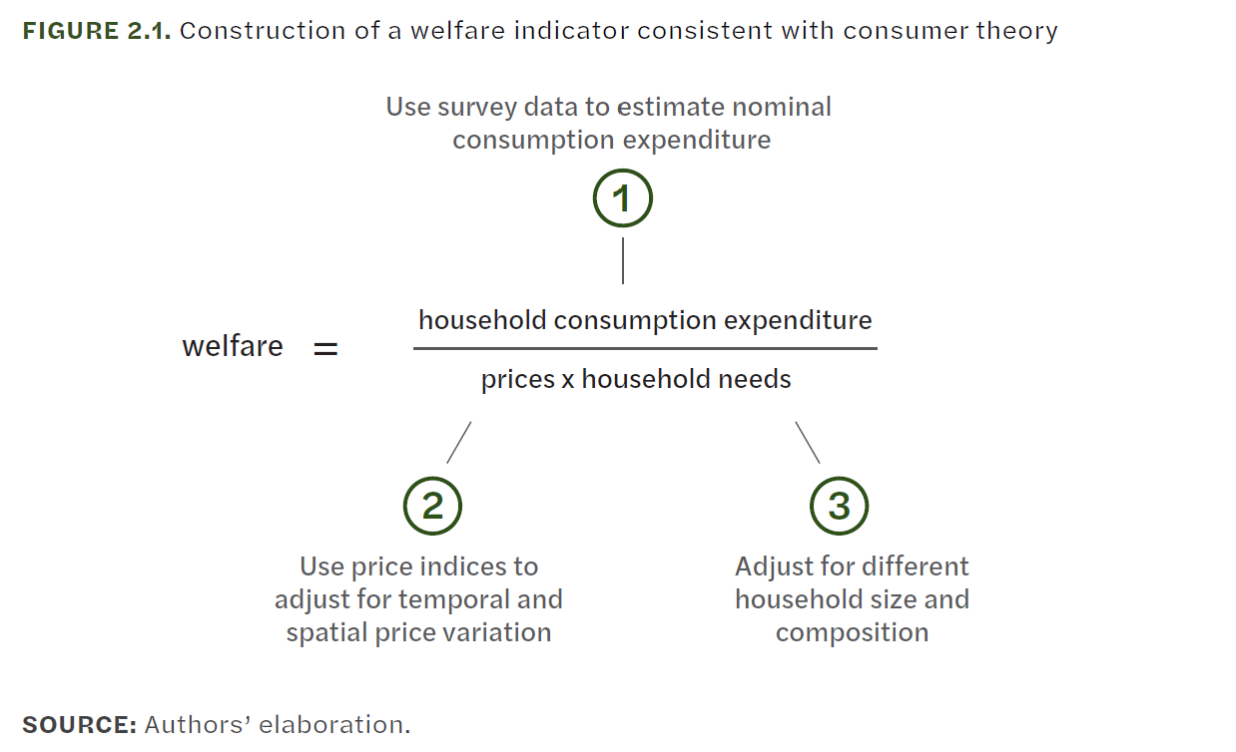
Adjustments to measure of household welfare
Having a nominal measure of consumption may not properly reflect a person’s standard of living.
Mancini & Vecchi (2022)

Slide 29
Prices
Prices vary by location.
Lower prices in rural areas may lead to lower consumption.
Comparing prices of different periods is important.

Slide 30
Scale Equivalence
A household of 2 consumes more than a household of 1.
How much do children need?
How about different age groups and gender differences in consumption?
Some goods are public goods.

